Slide 1

Object Oriented Design with UML
Lecture 2
Data Structures and Abstractions

Slide 2
Overview
Before starting here, you need to have gone through the ideas and concepts introduced in Lec-01-intro.ppt.
We will look at the use of the Unified Modelling Language (UML) for Object Oriented (OO) design.
We will be referring to “UML Distilled” by Fowler and Scott.
UML has it’s beginning with works by James Rumbaugh, Grady Booch and Ivar Jacobson. Each of them had their own way of “doing things” but started to collaborate. [1]
If you end up working with UML in industry, this book is a ‘must’.
Fowler also has a useful website: http://martinfowler.com/
We will be using StarUML to draw UML diagrams; it is available in the labs… maybe not all labs but as it is free you can install it yourself.
If you want to draw them at home it can be downloaded free from http://www.it.murdoch.edu.au/units/ICT209/staruml/ [2]
Notes:
[1] Rumbaugh, Booch and Jacobson are collectively known as the Three Amigos
[2] Teaching staff do not help with installation. In fact only ITS staff do installation.
Installing software is a skill you have to acquire with practice.

Slide 3
UML for Design
The most important design tool for OO is the Unified Modelling Language (UML). The Object Management Group oversees development of UML.
We will be using UML class diagrams extensively.
You will be using StarUML to draw these diagrams. This is not to say that these diagrams can’t be drawn by hand or by some other tool like Microsoft Visio, ArgoUML, BOUML, .. etc. [1]
UML shows the relationship between classes.
It can also show the attributes and methods in a class.
An initial UML diagram (version 01) is bound to be incorrect, so it gets updated as you change the design (versions 02, 03...).
It forms the main type of class documentation for this unit.
Notes:
[1] You need to be able to draw by hand in the exam or if there are class tests, exercises.

Slide 4
Diagram Basics
All diagrams (whether UML, ERD etc) should have:
  a title
  a key
  version history; for each version
    the version number
    the date of the version
    the author of the version
    brief description of the changes
All neatly laid out on the diagram.
With useful use of pale colours as appropriate.

Slide 5
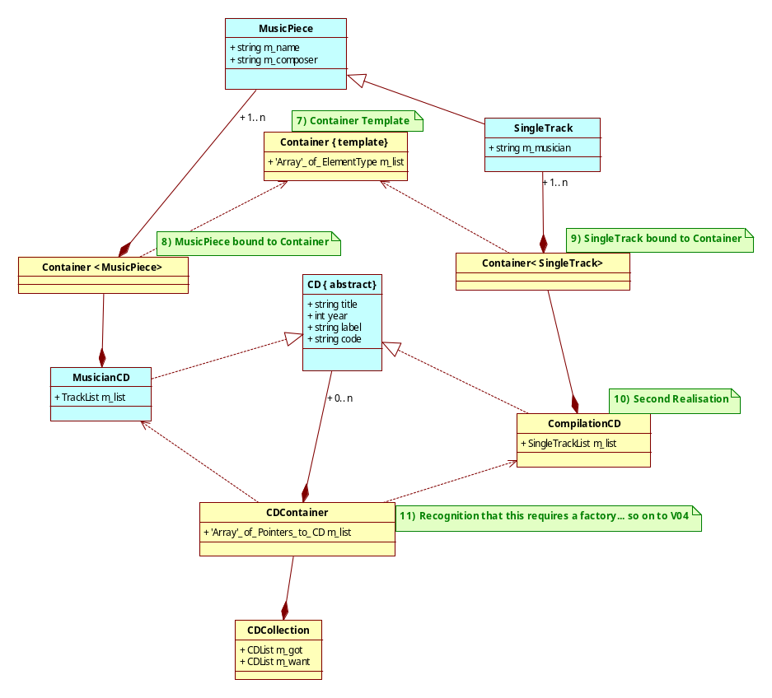
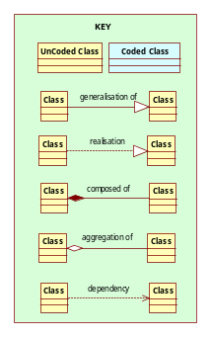
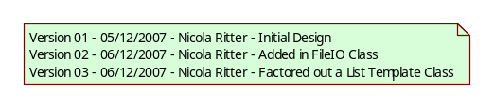
Example Layout
The Title

Slide 6
Notes on Diagram Layout
Try to keep classes in line vertically and horizontally.
Try to ensure that lines do not cross.
If the key and history are too large then they may need to go on a separate page, however this risks them getting separated from the main diagram.
If everyone is using the same software and the software has a key down the side, then parts of the key can be left out, and the history may be able to go elsewhere.
This, of course, applies in this unit.

Slide 7
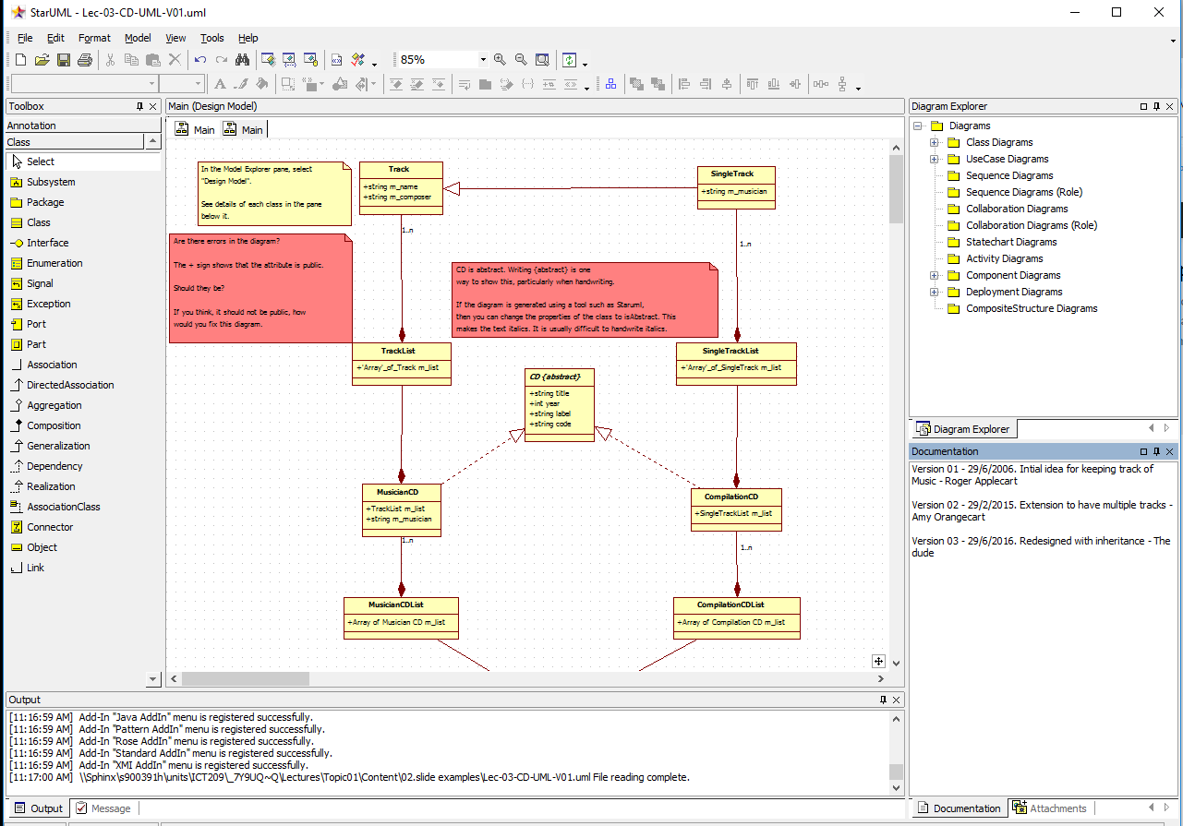
For writing comments or notes
Class diagram for this unit
Area for drawing UML diagram
UML connectors
toolbox
Connectors used
for class relationships
A class
To Document the UML design

Slide 8
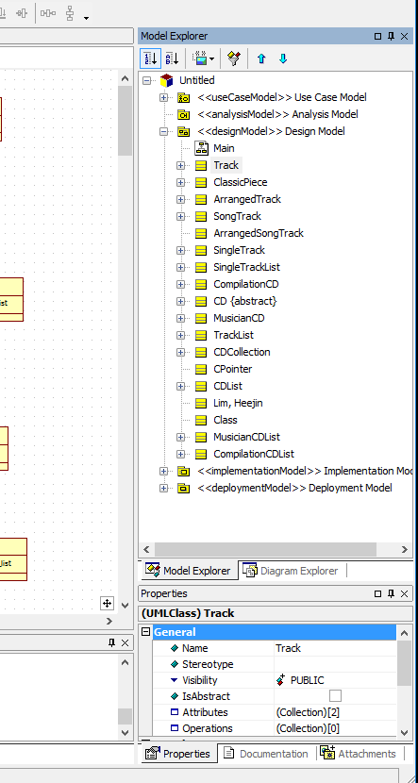
To view/set detailed properties
Selected class
StarUML interface
Properties of
the selected class
The properties

Slide 9
Standards in UML
UML is supposed to be “unified” and therefore “standard”.
  Ok, but not everyone plays by the rules ...
Even finding out exactly what the standards are is difficult.
And the standards have alternatives in them!
And, of course, then you have to find software that supports the full standard.
On top of which, the standards rely very heavily on symbols not words, whereas a word can be clearer.
So we will stick as “close” to the standards as we can, given that we are using StarUML and we want clear, useful diagrams.

Slide 10
Class Types
There are many different types of classes.
Basic or simple classes are those whose member variables are all of types that are built into the language, for example int, float, bool, string (if available).
Composite classes are those that have at least one member variable that is of another class type.
Interface classes are those that have no data members and no implementation. They simply define an interface (set of methods) that other classes must implement.
Abstract classes are those that provide an interface, but which may also have some data members and some implementation.
Template classes have data and a complete implementation, however the type of the data is not instantiated until compile-time.
  Note that a type that is described using a template and an instantiating type is known as a bound element.

Slide 11
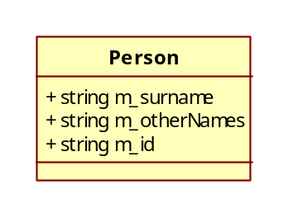
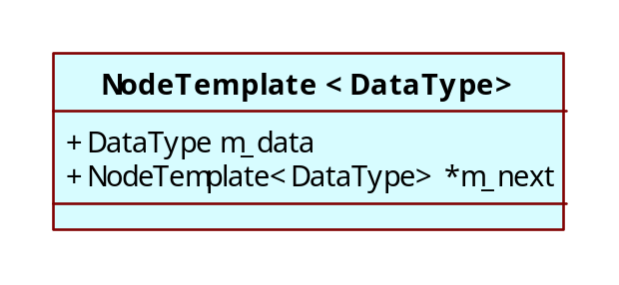
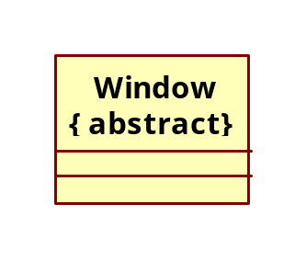
Our UML Standard for Classes
Simple and composite classes will just be labelled with the class name
Template classes will be shown with the template parameter in a dashed box.
Interface and abstract classes (and all other classes with qualifiers) will have the class name followed by the qualifying information in {} braces if you are not planning to generate code automatically.

Slide 12
Class Relationships
There are many different potential relationships (associations) between classes.
Coupling is introduced when classes are related.
In this unit we will examine:
  dependency
  composition
  aggregation
  specialisation
  realisation

Slide 13
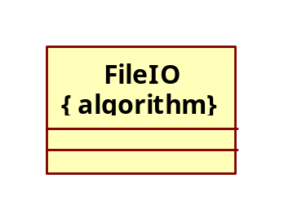
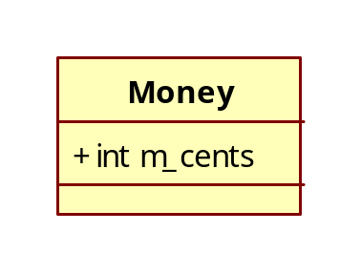
Dependency
Described as ‘needs’, ‘uses’, ‘requires’. As Fowler [1] puts it “A dependency exists between two elements if changes to the definition of one element (the supplier) may cause changes to the other (the client)”
It is used when one class uses another within its code.
For example, writing to a binary file is messy, so quite often one encapsulates the functions for binary file writing, into a class containing only algorithms. (FileIO).
In UML dependencies are shown with a dotted line and a simple arrow. In this example ‘Money’ depends on ‘FileIO’.
Note that the FileIO class has the qualifier {algorithm} indicating that it has no member variables, only algorithms.
You draw this relationship if the other relationships are not appropriate but there is a dependency, via, say, parameter passing, or method call.
If a class contains another class as a data member, there is a dependency, but you indicate the dependency using an encapsulation (or aggregation) relationship and not this dotted arrow notation.
Notes:
[1] UML Distilled: A Brief Guide to the Standard Object Modeling Language, Third Edition by Martin Fowler.
http://0-proquestcombo.safaribooksonline.com.prospero.murdoch.edu.au/book/software-engineering-and-development/uml/0321193687
“A dependency exists between two elements if changes to the definition of one element (the supplier) may cause changes to the other (the client). With classes, dependencies exist for various reasons: One class sends a message to another; one class has another as part of its data; one class mentions another as a parameter to an operation. If a class changes its interface, any message sent to that class may no longer be valid.
As computer systems grow, you have to worry more and more about controlling dependencies. If dependencies get out of control, each change to a system has a wide ripple effect as more and more things have to change. The bigger the ripple, the harder it is to change anything.
The UML allows you to depict dependencies between all sorts of elements. You use dependencies whenever you want to show how changes in one element might alter other elements.”
“Your general rule should be to minimize dependencies, particularly when they cross large areas of a system. In particular, you should be wary of cycles, as they can lead to a cycle of changes. I’m not super strict on this. I don’t mind mutual dependencies between closely related classes, but I do try to eliminate cycles at a broader level, particularly between packages. “
Dependencies can cause a “jelly effect” on the system. Remember, we want low coupling – see lecture 1.

Slide 14
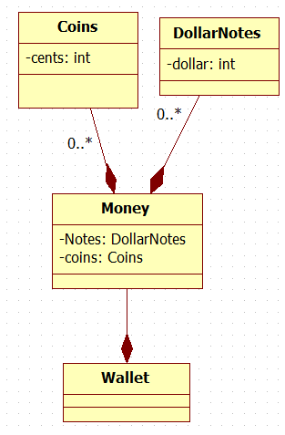
Composition
Conventionally described as ‘has a’.
One class has a data member that is the type of another class.
And when the object disappears, all its parts usually disappear too.
For example a wallet has a set of Money amounts.
Money consists of Notes and Coins
This relationship is shown in UML with a solid line and a solid diamond at the non-dependent (whole) end.
If the ‘whole’ contains more than one of the same ‘parts’ a multiplicity should be included.
The multiplicity can be a single number (5), a defined range (0..4), or an open-ended range (0..*).
StarUML allows the connection to be labelled using the attribute name used to represent money inside MoneyArray.
If you loose your wallet, you loose your money.
With money, you can give away coins or notes.
There are other ways to model the relationship.
END

Slide 15
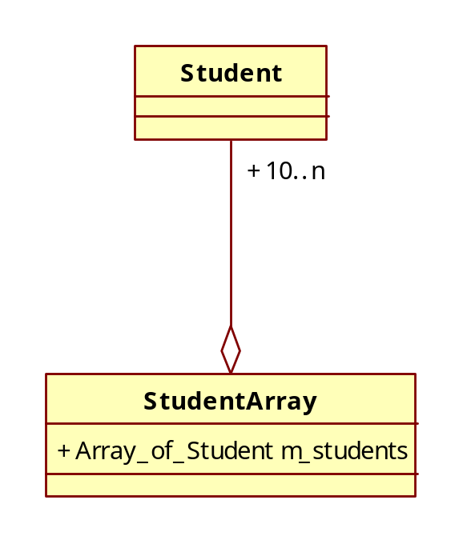
Aggregation
Described as ‘has a’.
One class has a data member that is the type of another class.
However, when the whole disappears, the parts do not.
For example an array of students in a unit. When the array disappears, the students do not!
This relationship is shown in UML with a solid line and an open diamond at the non-dependent (whole) end.
As with composition, there should be a multiplicity if the relationship is not 1 to 1.
END

Slide 16
Specialisation
When a new class has all the characteristics of another class, but then adds information, it is called a specialisation.
We derive a child class from a parent class and then add to the child.
Sometimes the relationship is expressed differently and we say the parent class generalises the child class.
One class is a specialisation of another class if and only if:
  You can relate them in English using ‘is a’ in a behavioural sense [1]
  For example, ‘a car is a wheeled vehicle’.
  and
  The child class uses every member variable declared in the parent class.
  and
  The child class requires every method defined in the parent class.
Notes:
1.
A common mistake is to say a square has an “is-a” relationship with rectangle, or a square is a special case of a rectangle
They are *not* the same behaviorally, so specliasation cannot occur. i.e. Parent-child relationship must *not* be done.
The same argument applies to oval and circle.

Slide 17
Specialisation
If you don’t follow all of these rules, your design will violate the Liskov Substitution Principle (LSP) – the “L” in S.O.L.I.D principles.
“If for each object o1 of type S there is an object o2 of type T such that for all programs P defined in terms of T, the behavior of P is unchanged when o1 is substituted for o2 then S is a subtype of T.”
“S is is a subtype of T” means S is a child of T; or T is the parent of S.
For correct parent-child relationship to occur, a program written in terms of objects of type T (the parent), you can substitute these objects of T (parent) with objects of the subtype S (child) without changing program behaviour.
  If the behaviour changes, then there is no reliable parent child relationship between types T and S. If you have designed an inheritance relationship between Class T and Class S, you have made a mistake.

Slide 18
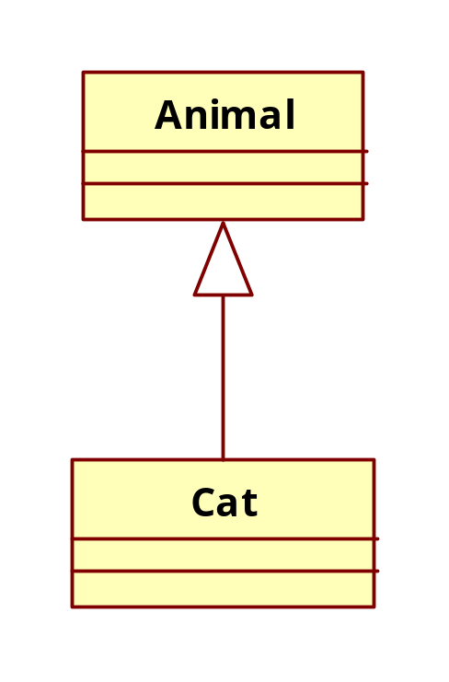
Specialisation cont.
Examples of correct specialisation:
  a cat is an animal
  a car is a transport vehicle
Example of poor specialisation:
  a square is a rectangle
  (but it has no width, so it should not be derived from rectangle)
Specialisation (generalisation in StarUML) is shown with a solid line and a hollow triangular arrow.
In C++ specialisation is achieved by having the child inherit from the parent class.
Arrow head is with the parent.
END

Slide 19
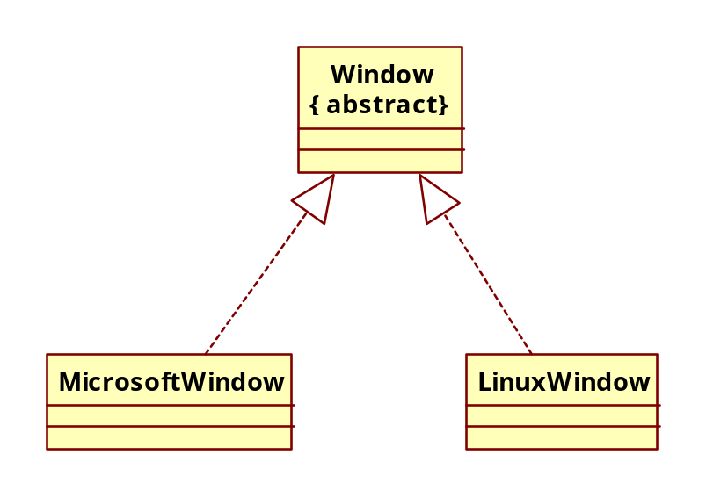
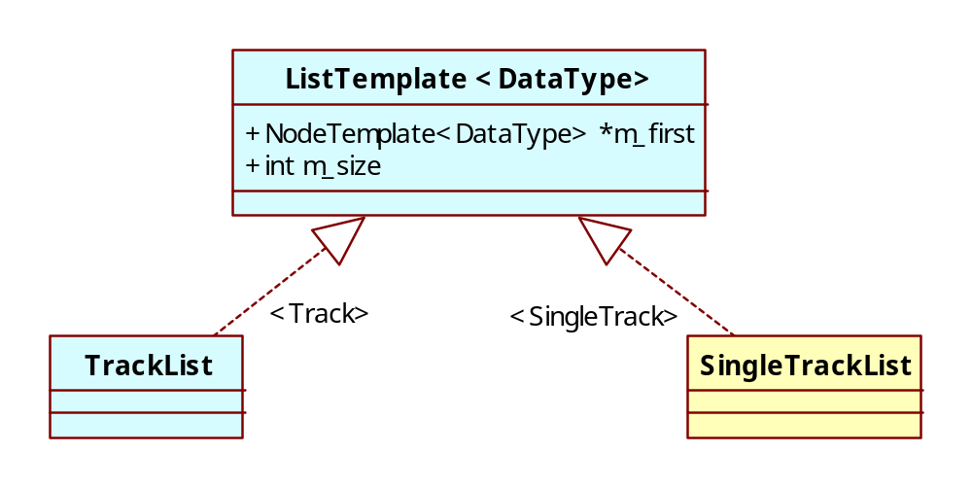
Realisation
Abstract, template and interface classes define all or part of a class.
None of these types of classes can be used until they are realised as a completed class.
For example an abstract class might be set up called a Window, this could then be realised as a Microsoft Window or a Linux Window. [1]
In UML realisation is shown with the same arrowhead as specialisation, but with a dotted line.
Where it is a realisation of a template, the DataType qualifies the relationship [2]
Notes:
1.
See an example at http://www.uml-diagrams.org/design-pattern-abstract-factory-uml-class-diagram-example.html
2.
The diagram is for the handwritten version.
If using a tool, see this example of a template class is at the end of http://www.uml-diagrams.org/class.html (scroll down)

Slide 20
Our Application
Lecture example (next slide set) shows how to code an application to store data about a CD music collection.
I have chosen this because it is not too difficult and it is possible to cover almost everything in the unit. But we will be looking at other code too.
The labs would be using different code and the unit textbook uses other examples, so you get exposure to more than just one or two examples.

Slide 21
Readings
UML Distilled: A Brief Guide to the Standard Object Modeling Language, Third Edition
http://proquestcombo.safaribooksonline.com.libproxy.murdoch.edu.au/book/software-engineering-and-development/uml/0321193687
Data Abstraction and Hierarchy by Barbara Liskov. Original paper describing what became knows as the Liskov Substitution Principle (LSP). For an overview, see https://en.wikipedia.org/wiki/Liskov_substitution_principle
LSP is one of the principles of SOLID. This is something that you need to become comfortable with at the end of the unit, and this knowledge is directly relevant to anyone working in a software development role. For an overview see https://en.wikipedia.org/wiki/SOLID_(object-oriented_design) and the references provided there.

